Slide 1
Objectives
  State the components of a SAS program.
  State the modes in which you can run a SAS program.

Slide 2
SAS Programs
A SAS program is a sequence of steps that the user submits for execution.
Raw
Data
DATA steps are typically used to create SAS data sets.
DATA
Step
SAS
Data Set
PROC
Step
Report
SAS
Data Set
PROC steps are typically used to process SAS data sets (that is, generate reports and graphs, edit data, and sort data).

Slide 3
SAS Programs
data work.staff;
infile 'raw-data-file';
input LastName $ 1-20 FirstName $ 21-30
JobTitle $ 36-43 Salary 54-59;
run;
proc print data=work.staff;
run;
proc means data=work.staff;
class JobTitle;
var Salary;
run;
DATA Step
PROC Steps

Slide 4
Step Boundaries
SAS steps begin with a
  DATA statement
  PROC statement.
SAS detects the end of a step when it encounters
  a RUN statement (for most steps)
  a QUIT statement (for some procedures)
  the beginning of another step (DATA statement or PROC statement).

Slide 5
Step Boundaries
data work.staff;
infile 'raw-data-file';
input LastName $ 1-20 FirstName $ 21-30
JobTitle $ 36-43 Salary 54-59;
run;
proc print data=work.staff;
proc means data=work.staff;
class JobTitle;
var Salary;
run;

Slide 6
Running a SAS Program
You can invoke SAS in
  interactive windowing mode (SAS windowing environment)
  interactive menu-driven mode (SAS Enterprise Guide, SAS/ASSIST, SAS/AF, or SAS/EIS software)
  batch mode
  noninteractive mode.

Slide 7
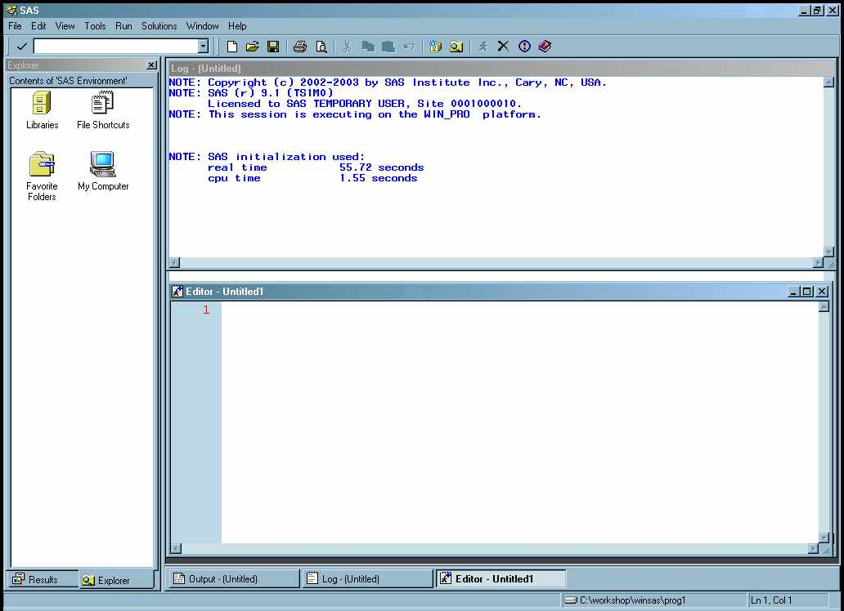
SAS Windowing Environment
Interactive windows enable you to interface with SAS.

Slide 8
z/OS (OS/390, MVS) Batch Execution
Place the JCL appropriate for your location before your SAS statements.
//jobname JOB accounting info,name …
// EXEC SAS
//SYSIN DD *
data work.staff;
infile 'raw-data-file';
input LastName $ 1-20 FirstName $ 21-30
JobTitle $ 36-43 Salary 54-59;
run;
proc print data=work.staff;
run;
proc means data=work.staff;
class JobTitle;
var Salary;
run;

Slide 9
Noninteractive Execution (Optional)
To execute a SAS program in noninteractive mode,
  use an editor to store the program in a file. (Directory-based users should use a filetype or extension of SAS.)
  identify the file when you invoke SAS.
Directory-based:
z/OS (OS/390, TSO):
SAS filename
SAS INPUT(filename)

Slide 10
Section 2.2
Running SAS Programs

Slide 11
Objectives
  Invoke the SAS System and include a SAS program into your session.
  Submit a program and browse the results.
  Navigate the SAS windowing environment.

Slide 12
Submitting a SAS Program
When you execute a SAS program, the output generated by SAS is divided into two major parts:
SAS log contains information about the processing of
the SAS program, including any warning and
error messages.
SAS output contains reports generated by SAS
procedures and DATA steps.

Slide 13
SAS Log
1 data work.staff;
2 infile 'raw-data-file';
3 input LastName $ 1-20 FirstName $ 21-30
4 JobTitle $ 36-43 Salary 54-59;
5 run;
NOTE: The infile 'raw-data-file' is:
File Name= 'raw-data-file',
RECFM=V,LRECL=256
NOTE: 18 records were read from the infile 'raw-data-file'.
The minimum record length was 59.
The maximum record length was 59.
NOTE: The data set WORK.STAFF has 18 observations and 4 variables.
6 proc print data=work.staff;
7 run;
NOTE: There were 18 observations read from the dataset WORK.STAFF.
8 proc means data=work.staff;
9 class JobTitle;
10 var Salary;
11 run;
NOTE: There were 18 observations read from the dataset WORK.STAFF.

Slide 14
PROC PRINT Output
The SAS System
First
Obs LastName Name JobTitle Salary
1 TORRES JAN Pilot 50000
2 LANGKAMM SARAH Mechanic 80000
3 SMITH MICHAEL Mechanic 40000
4 LEISTNER COLIN Mechanic 36000
5 WADE KIRSTEN Pilot 85000
6 TOMAS HARALD Pilot 105000
7 WAUGH TIM Pilot 70000
8 LEHMANN DAGMAR Mechanic 64000
9 TRETTHAHN MICHAEL Pilot 100000
10 TIETZ OTTO Pilot 45000
11 O'DONOGHUE ART Mechanic 52000
12 WALKER THOMAS Pilot 95000
13 NOROVIITA JOACHIM Mechanic 78000
14 OESTERBERG ANJA Mechanic 80000
15 LAUFFER CRAIG Mechanic 40000
16 TORR JUGDISH Pilot 45000
17 WAGSCHAL NADJA Pilot 77500
18 TOERMOEN JOCHEN Pilot 65000

Slide 15
PROC MEANS Output
The SAS System
The MEANS Procedure
Analysis Variable : Salary
N
JobTitle Obs N Mean Std Dev Minimum
ƒƒƒƒƒƒƒƒƒƒƒƒƒƒƒƒƒƒƒƒƒƒƒƒƒƒƒƒƒƒƒƒƒƒƒƒƒƒƒƒƒƒƒƒƒƒƒƒƒƒƒƒƒƒƒƒƒƒƒƒƒƒƒƒ
Mechanic 8 8 58750.00 19151.65 36000.00
Pilot 10 10 73750.00 22523.14 45000.00
ƒƒƒƒƒƒƒƒƒƒƒƒƒƒƒƒƒƒƒƒƒƒƒƒƒƒƒƒƒƒƒƒƒƒƒƒƒƒƒƒƒƒƒƒƒƒƒƒƒƒƒƒƒƒƒƒƒƒƒƒƒƒƒƒ
Analysis Variable : Salary
N
JobTitle Obs Maximum
ƒƒƒƒƒƒƒƒƒƒƒƒƒƒƒƒƒƒƒƒƒƒƒƒƒƒƒƒƒ
Mechanic 8 80000.00
Pilot 10 105000.00
ƒƒƒƒƒƒƒƒƒƒƒƒƒƒƒƒƒƒƒƒƒƒƒƒƒƒƒƒƒ

Slide 16

Running a SAS Program c02s2d1.sas userid.prog1.sascode(c02s2d1)
This demonstration illustrates how to start a
SAS session, include and submit a SAS program,
and browse the results.

Slide 17

Exercises
This exercise reinforces the concepts discussed previously.

Slide 18
Section 2.3
Mastering Fundamental Concepts

Slide 19
Objectives
  Define the components of a SAS data set.
  Define a SAS variable.
  Identify a missing value and a SAS date value.
  State the naming conventions for SAS data sets and variables.
  Explain SAS syntax rules.
  Investigate a SAS data set using the CONTENTS and PRINT procedures.

Slide 20
SAS Data Sets
Other Software Files
Data
Entry
External File
Conversion Process
SAS
Data Set
Descriptor Portion
Data Portion

Slide 21
SAS Data Sets
SAS data sets have a descriptor portion and a data portion.
General data set information
* data set name * data set label
* date/time created * storage information
* number of observations
Information for each variable
* Name * Type * Length * Position
* Format * Informat * Label
Descriptor Portion
Data Portion

Slide 22
Browsing the Descriptor Portion
The descriptor portion of a SAS data set contains
  general information about the SAS data set (such as data set name and number of observations)
  variable attributes (name, type, length, position, informat, format, label).
The CONTENTS procedure displays the descriptor portion of a SAS data set.

Slide 23
Browsing the Descriptor Portion
General form of the CONTENTS procedure:
Example:
PROC CONTENTS DATA=SAS-data-set;
RUN;
proc contents data=work.staff;
run;
c02s3d1

Slide 24
Partial PROC CONTENTS Output
The SAS System
The CONTENTS Procedure
Data Set Name: WORK.STAFF Observations: 18
Member Type: DATA Variables: 4
Engine V9 Indexes 0
Created Monday, December 01, Observation Length 48
2003 10:36:59 AM
Last Modified Monday, December 01, Deleted Observations 0
2003 10:36:59 AM
Protection: Compressed: NO
Data Set Type: Sorted: NO
Label:
Alphabetic List of Variables and Attributes
# Variable Type Len
2 FirstName Char 10
3 JobTitle Char 8
1 LastName Char 20
4 Salary Num 8

Slide 25
SAS Data Sets: Data Portion
The data portion of a SAS data set is a rectangular table of character and/or numeric data values.
Variable
names
LastName FirstName JobTitle Salary
TORRES JAN Pilot 50000
LANGKAMM SARAH Mechanic 80000
SMITH MICHAEL Mechanic 40000
WAGSCHAL NADJA Pilot 77500
TOERMOEN JOCHEN Pilot 65000
Variable
values
Character values
Numeric
values

Slide 26
SAS Variable Values
There are two types of variables:
character contain any value: letters, numbers, special characters, and blanks. Character values are stored with a length of 1 to 32,767 bytes. One byte equals one character.
numeric stored as floating point numbers in 8 bytes
of storage by default. Eight bytes of floating point storage provide space for 16 or 17 significant digits. You are not restricted to
8 digits.

Slide 27
SAS Data Set and Variable Names
SAS names
  can be 32 characters long.
  can be uppercase, lowercase, or mixed-case.
  must start with a letter or underscore. Subsequent characters can be letters, underscores, or numeric digits.

Slide 28
Valid SAS Names
Select the valid default SAS names.
□ data5mon
◻ 5monthsdata
◻ data#5
◻ five months data
□ fivemonthsdata

Slide 29
Valid SAS Names
Select the default valid SAS names.
□ data5mon
☑ data5mon
◻ 5monthsdata
◻ data#5
◻ five months data
□ fivemonthsdata
☑ fivemonthsdata

Slide 30
SAS Date Values
SAS stores date values as numeric values.
A SAS date value is stored as the number of days between January 1, 1960, and a specific date.
01JAN1959
01JAN1960
01JAN1961
store
-365
0
366
display
01/01/1959
01/01/1960
01/01/1961

Slide 31
Missing Data Values
A value must exist for every variable for each observation.
Missing values are valid values.
LastName FirstName JobTitle Salary
TORRES JAN Pilot 50000
LANGKAMM SARAH Mechanic 80000
SMITH MICHAEL Mechanic . WAGSCHAL NADJA Pilot 77500
TOERMOEN JOCHEN 65000
A character missing value is displayed as a blank.
A numeric missing value is displayed as a period.

Slide 32
Browsing the Data Portion
The PRINT procedure displays the data portion of a
SAS data set.
By default, PROC PRINT displays
  all observations
  all variables
  an Obs column on the left side.

Slide 33
Browsing the Data Portion
General form of the PRINT procedure:
Example:
PROC PRINT DATA=SAS-data-set;
RUN;
proc print data=work.staff;
run;
c02s3d1
Notes:
When there are too many columns to fit on one line, they are split into multiple lines by PROC PRINT.

Slide 34
PROC PRINT Output
The SAS System
First
Obs LastName Name JobTitle Salary
1 TORRES JAN Pilot 50000
2 LANGKAMM SARAH Mechanic 80000
3 SMITH MICHAEL Mechanic 40000
4 LEISTNER COLIN Mechanic 36000
5 WADE KIRSTEN Pilot 85000
6 TOMAS HARALD Pilot 105000
7 WAUGH TIM Pilot 70000
8 LEHMANN DAGMAR Mechanic 64000
9 TRETTHAHN MICHAEL Pilot 100000
10 TIETZ OTTO Pilot 45000
11 O'DONOGHUE ART Mechanic 52000
12 WALKER THOMAS Pilot 95000
13 NOROVIITA JOACHIM Mechanic 78000
14 OESTERBERG ANJA Mechanic 80000
15 LAUFFER CRAIG Mechanic 40000
16 TORR JUGDISH Pilot 45000
17 WAGSCHAL NADJA Pilot 77500
18 TOERMOEN JOCHEN Pilot 65000

Slide 35
SAS Data Set Terminology
SAS documentation and text in the SAS windowing environment use the following terms interchangeably:
SAS Data Set
SAS Table
Variable
Column
Observation
Row

Slide 36
SAS Syntax Rules
SAS statements
  usually begin with an identifying keyword
  always end with a semicolon.
data work.staff;
infile 'raw-data-file';
input LastName $ 1-20 FirstName $ 21-30
JobTitle $ 36-43 Salary 54-59;
run;
proc print data=work.staff;
run;
proc means data=work.staff;
class JobTitle;
var Salary;
run;

Slide 37
SAS Syntax Rules
  SAS statements are free-format.
  One or more blanks or special characters can be used to separate words.
  They can begin and end in any column.
  A single statement can span multiple lines.
  Several statements can be on the same line.
Unconventional Spacing
data work.staff;
infile 'raw-data-file';
input LastName $ 1-20 FirstName $ 21-30
JobTitle $ 36-43 Salary 54-59;
run;
proc means data=work.staff;
class JobTitle; var Salary;run;
...

Slide 38
SAS Syntax Rules
  SAS statements are free-format.
  One or more blanks or special characters can be used to separate words.
  They can begin and end in any column.
  A single statement can span multiple lines.
  Several statements can be on the same line.
Unconventional Spacing
data work.staff;
infile 'raw-data-file';
input LastName $ 1-20 FirstName $ 21-30
JobTitle $ 36-43 Salary 54-59;
run;
proc means data=work.staff;
class JobTitle; var Salary;run;
...

Slide 39
SAS Syntax Rules
  SAS statements are free-format.
  One or more blanks or special characters can be used to separate words.
  They can begin and end in any column.
  A single statement can span multiple lines.
  Several statements can be on the same line.
Unconventional Spacing
data work.staff;
infile 'raw-data-file';
input LastName $ 1-20 FirstName $ 21-30
JobTitle $ 36-43 Salary 54-59;
run;
proc means data=work.staff;
class JobTitle; var Salary;run;

Slide 40
SAS Syntax Rules
  SAS statements are free-format.
  One or more blanks or special characters can be used to separate words.
  They can begin and end in any column.
  A single statement can span multiple lines.
  Several statements can be on the same line.
Unconventional Spacing
data work.staff;
infile 'raw-data-file';
input LastName $ 1-20 FirstName $ 21-30
JobTitle $ 36-43 Salary 54-59;
run;
proc means data=work.staff;
class JobTitle; var Salary;run;
...

Slide 41
SAS Syntax Rules
...
  SAS statements are free-format.
  One or more blanks or special characters can be used to separate words.
  They can begin and end in any column.
  A single statement can span multiple lines.
  Several statements can be on the same line.
Unconventional Spacing
data work.staff;
infile 'raw-data-file';
input LastName $ 1-20 FirstName $ 21-30
JobTitle $ 36-43 Salary 54-59;
run;
proc means data=work.staff;
class JobTitle; var Salary;run;

Slide 42
SAS Syntax Rules
...
  SAS statements are free-format.
  They can begin and end in any column.
  One or more blanks or special characters can be used to separate words.
  A single statement can span multiple lines.
  Several statements can be on the same line.
Unconventional Spacing
data work.staff;
infile 'raw-data-file';
input LastName $ 1-20 FirstName $ 21-30
JobTitle $ 36-43 Salary 54-59;
run;
proc means data=work.staff;
class JobTitle; var Salary;run;

Slide 43
SAS Syntax Rules
Good spacing makes the program easier to read.
Conventional Spacing
data work.staff;
infile 'raw-data-file';
input LastName $ 1-20 FirstName $ 21-30
JobTitle $ 36-43 Salary 54-59;
run;
proc print data=work.staff;
run;
proc means data=work.staff;
class JobTitle;
var Salary;
run;

Slide 44
SAS Comments
Type /* to begin a comment.
Type your comment text.
Type */ to end the comment.
/* Create work.staff data set */
data work.staff;
infile 'raw-data-file';
input LastName $ 1-20 FirstName $ 21-30
JobTitle $ 36-43 Salary 54-59;
run;
/* Produce listing report of work.staff */
proc print data=work.staff;
run;
c02s3d2

Slide 45
Exercises
This exercise reinforces the concepts discussed previously.

Slide 46
Section 2.4
Diagnosing and Correcting
Syntax Errors

Slide 47
Objectives
  Identify SAS syntax errors.
  Debug and edit a program with errors.
  Resubmit the corrected program.
  Save the corrected program.

Slide 48
Syntax Errors
Syntax errors include
  misspelled keywords
  missing or invalid punctuation
  invalid options.
daat work.staff;
infile 'raw-data-file';
input LastName $ 1-20 FirstName $ 21-30
JobTitle $ 36-43 Salary 54-59;
run;
proc print data=work.staff
run;
proc means data=work.staff average max;
class JobTitle;
var Salary;
run;

Slide 49
Debugging a SAS Program c02s4d1.sas userid.prog1.sascode(c02s4d1) c02s4d2.sas userid.prog1.sascode(c02s4d2)
This demonstration illustrates how to submit a
SAS program that contains errors, diagnose the errors, correct the errors, and save the corrected program.

Slide 50
Recall a Submitted Program
Program statements accumulate in a recall buffer each time you issue a SUBMIT command.
daat work.staff;
infile 'raw-data-file';
input LastName $ 1-20 FirstName $ 21-30
JobTitle $ 36-43 Salary 54-59;
run;
proc print data=work.staff
run;
proc means data=work.staff average max;
class JobTitle;
var Salary;
run;
data work.staff;
infile 'raw-data-file';
input LastName $ 1-20 FirstName $ 21-30
JobTitle $ 36-43 Salary 54-59;
run;
proc print data=work.staff;
run;
proc means data=work.staff mean max;
class Jobtitle;
var Salary;
run;
Submit Number 1
Submit Number 2

Slide 51
Recall a Submitted Program
Issue the RECALL command once to recall the most recently submitted program.
data work.staff;
infile 'raw-data-file';
input LastName $ 1-20 FirstName $ 21-30
JobTitle $ 36-43 Salary 54-59;
run;
proc print data=work.staff;
run;
proc means data=work.staff mean max;
class JobTitle;
var Salary;
run;
Submit Number 1
Issue RECALL once.
Submit Number 2
Submit number 2 statements are recalled.

Slide 52
Recall a Submitted Program
Issue the RECALL command again to recall submit number 1 statements.
daat work.staff;
infile 'raw-data-file';
input LastName $ 1-20 FirstName $ 21-30
JobTitle $ 36-43 Salary 54-59;
run;
proc print data=work.staff
run;
proc means data=work.staff average max;
class JobTitle;
var Salary;
run;
data work.staff;
infile 'raw-data-file';
input LastName $ 1-20 FirstName $ 21-30
JobTitle $ 36-43 Salary 54-59;
run;
proc print data=work.staff;
run;
proc means data=work.staff mean max;
class JobTitle;
var Salary;
run;
Submit Number 1
Issue RECALL again.
Submit Number 2

Slide 53
Review: Save Your Program
Use the FILE command with the appropriate file naming convention for your operating environment.
z/OS (OS/390):
UNIX:
Windows:
FILE 'userid.prog1.sascode(myprog)'
FILE '/users/userid/myprog.sas'
FILE 'c:\workshop\winsas\prog1\myprog.sas'

Slide 54
Exercises
This exercise reinforces the concepts discussed previously.

Slide 55
Section 2.5
Exploring Your SAS Environment
(Self-Study)

